Slide 1
Application Delivery Fundamentals 2.0 B: Java
Spring Boot

Slide 2
Spring Boot
Goals
Understand the fundamentals of Spring Boot 3.x and its ecosystem.
Be able to create production-ready Spring Boot applications with modern Java.
Build and consume REST APIs with Spring Boot.
Implement Spring Security to secure applications using JWT.
Handle database migrations and perform CRUD operations using Spring Data JPA.
Develop microservices with Spring Boot and Spring Cloud.
Write unit and integration tests for Spring Boot applications.
Deploy Spring Boot applications in a Open shift environment.

Slide 3
Spring Boot Evolution

Slide 5
Spring Boot
Spring Boot is a Java-based framework built on top of the Spring Framework that helps you quickly create stand-alone, production-ready applications with minimal setup.
It’s widely used in microservices and enterprise applications because it reduces boilerplate code and simplifies configuration.

Slide 6
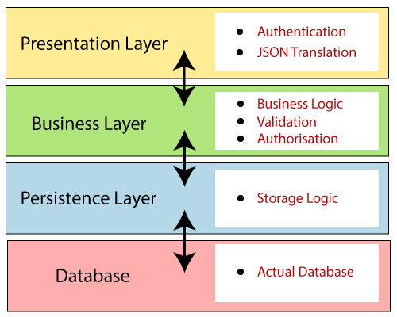
Spring Boot Architecture

Slide 7
Spring Boot Architecture
Controller Layer – Handles HTTP requests (@RestController, @Controller).
Service Layer – Business logic (@Service).
Repository Layer – Data access (@Repository, Spring Data JPA).
Entity Layer – Database entities (@Entity).

Slide 8
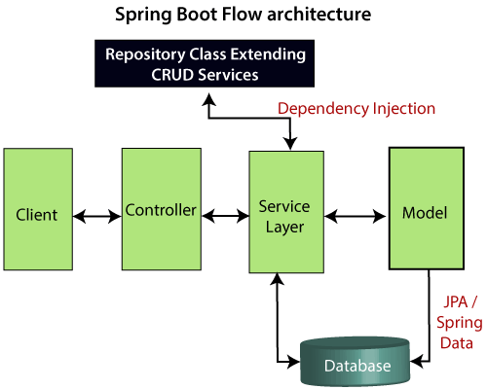
Spring boot Flow Architecture

Slide 9
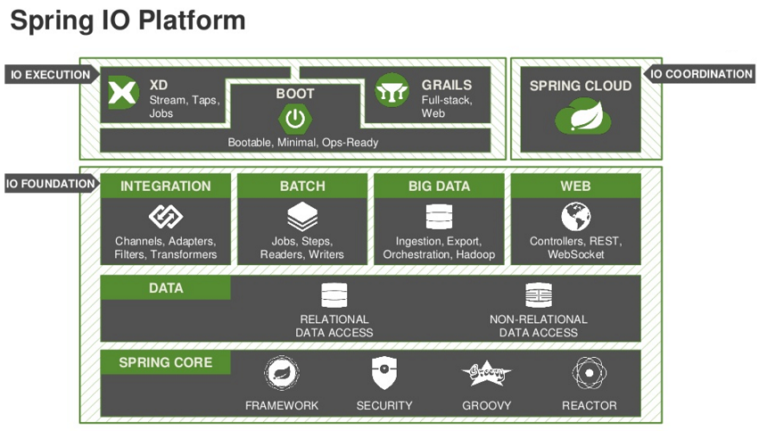
Spring IO platform

Slide 10
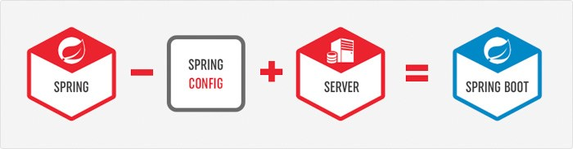
Spring Boot = a Sub-Project of Spring Framework

Slide 11
Spring Boot = a Sub-Project of Spring Framework

Slide 12
Spring Boot = a Sub-Project of Spring Framework

Slide 13
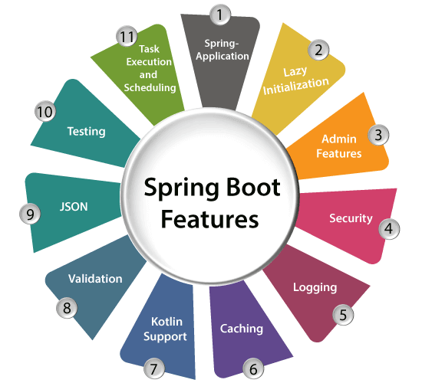
Spring boot features

Slide 14
Spring boot key features
Auto-Configuration:
Automatically configures beans and components based on the class path and dependencies.
Embedded Servers:
Runs with embedded Tomcat, Jetty, or Undertow—no need to deploy WAR files.
Production-Ready:
Includes health checks, metrics, externalized configuration, and monitoring (via Spring Boot Actuator).
Convention over Configuration:
Sensible defaults reduce the need for manual XML or Java config.
Starter Dependencies:
Predefined dependencies (like spring-boot-starter-web) make it easier to add features without version conflicts.

Slide 15
Common Use Cases
REST APIs & Microservices
Web Applications
Messaging Systems (Kafka, RabbitMQ)
Batch Processing
Cloud-Native Apps (Spring Cloud + Boot)

Slide 16
Spring Boot Modules

Slide 17
Spring Boot Modules
Spring Boot itself sits on top of the Spring Framework, but it’s organized into modules (starters and libraries) that provide different functionalities.
These modules are grouped into categories, so you only bring in what you need.

Slide 18
Spring Boot Modules
🌱 Core Spring Boot Modules
1. spring-boot
The base module of Spring Boot.
Provides the Spring Application class to bootstrap apps.
Auto-configuration engine.
Externalized configuration (application.properties / application.yml).

Slide 19
Spring Boot Modules
⚡ Web Modules
2. spring-boot-starter-web
For building RESTful web apps and microservices.
Includes Spring MVC, Jackson (JSON), Tomcat (by default).
Example: @RestController, @GetMapping, etc.
3. spring-boot-starter-webflux
For reactive programming using Spring WebFlux.
Based on Project Reactor.Runs on Netty by default.

Slide 20
Spring Boot Modules
🗄️ Data Access Modules
4. spring-boot-starter-data-jpa
ORM support using Hibernate + JPA.
Simplifies database access with Spring Data Repositories.
5. spring-boot-starter-data-mongodb
MongoDB document database support.
6. spring-boot-starter-data-redis
Redis key-value store integration.
7. spring-boot-starter-jdbc
Plain JDBC with connection pooling (HikariCP by default).
8. spring-boot-starter-data-cassandra / couchbase / neo4j / elasticsearch
Modules for specific NoSQL databases.

Slide 21
Spring Boot Modules
🔐 Security Modules
9. spring-boot-starter-security
Adds Spring Security for authentication & authorization.
Works with JWT, OAuth2, LDAP, etc.

Slide 22
Spring Boot Modules
📊 Monitoring & Production Modules
10. spring-boot-starter-actuator
Exposes health, metrics, environment, and custom endpoints.
Example: /actuator/health, /actuator/metrics.
11. spring-boot-admin (community project)
Web dashboard for monitoring multiple Spring Boot apps.

Slide 23
Spring Boot Modules
📬 Messaging Modules
12. spring-boot-starter-amqp
RabbitMQ support using Spring AMQP.
13. spring-boot-starter-kafka
Kafka producer/consumer support.

Slide 24
Spring Boot Modules
🎨 Frontend / Template Modules
14. spring-boot-starter-thymeleaf
For server-side rendering using Thymeleaf templates.
15. spring-boot-starter-mustache / freemarker
Alternative template engines.

Slide 25
Spring Boot Modules
🧪 Testing Modules
16. spring-boot-starter-test
Provides JUnit, Mockito, AssertJ, and Spring Test utilities.
Used for unit and integration testing.

Slide 26
Spring Boot Modules
☁️ Cloud & Distributed System Modules (via Spring Cloud)
17. spring-cloud-starter-netflix-eureka
Service discovery & registry.
18. spring-cloud-starter-openfeign
Declarative REST client.
19. spring-cloud-starter-gateway
API gateway for routing.
20. spring-cloud-starter-config
Centralized configuration management.

Slide 27
Spring Boot Modules
⚙️ Developer Tools
21. spring-boot-devtools
Enables hot reload, automatic restart, and debugging aids.

Slide 28
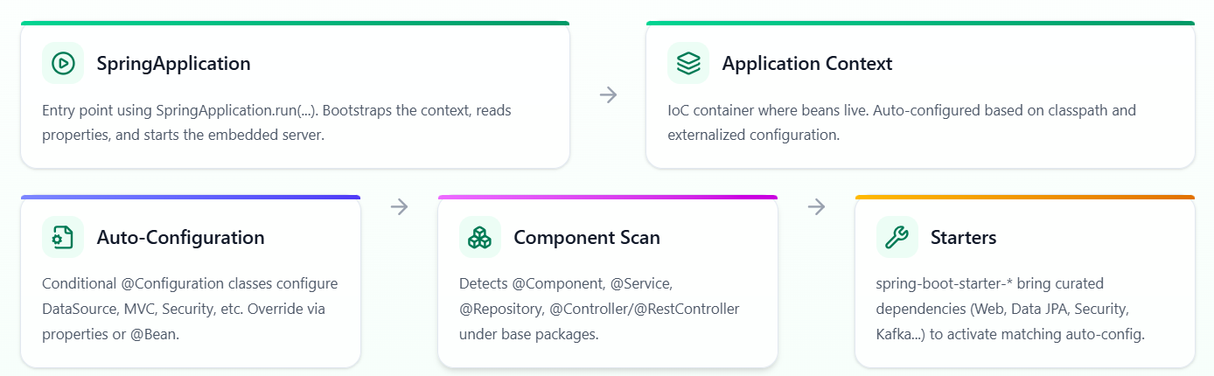
Spring Components

Slide 29
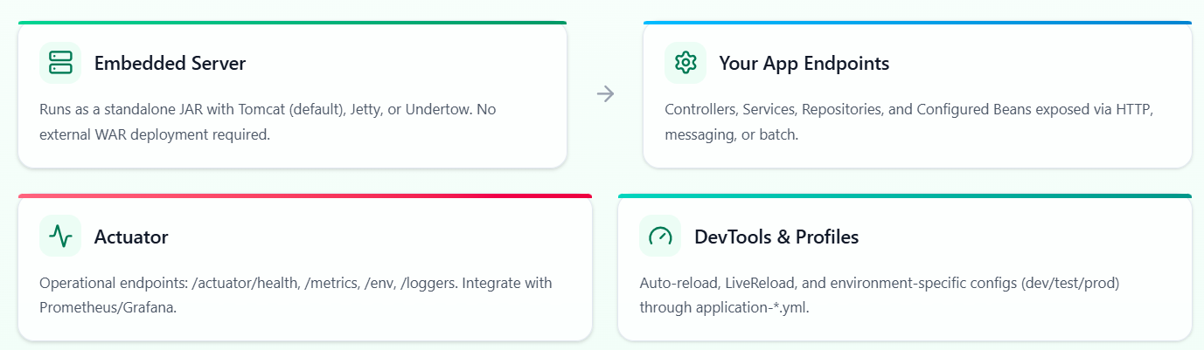
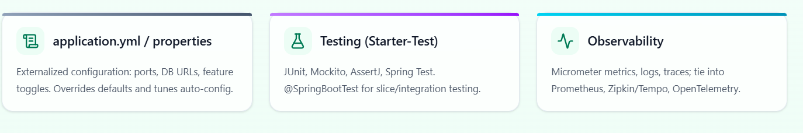
Spring Components

Slide 30
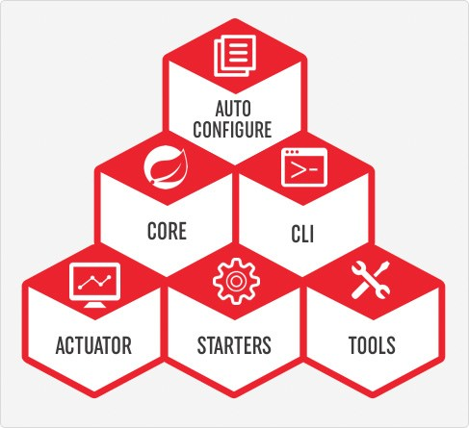
Spring Boot Components
Spring Boot CLI
A command line interface, based on ruby, to start/stop spring boot created applications.

Slide 31
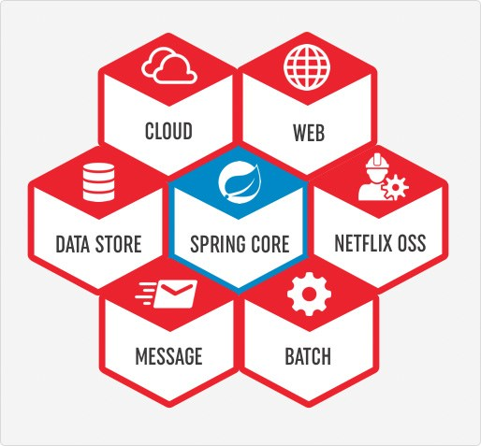
Spring Boot Starters

Slide 32
Spring Boot Starters
Spring Boot Starters are one of the biggest reasons Spring Boot is so popular.
They are pre-packaged dependency descriptors (basically curated Maven/Gradle dependency sets) that bring in everything you need for a given functionality — so you don’t have to manually hunt for and version-manage dozens of libraries.

Slide 33
Spring Boot Starters
🌟 What are Spring Boot Starters?
Special Maven/Gradle modules named as spring-boot-starter-*.
Provide a convenient entry point to commonly used features (Web, JPA, Security, Messaging, etc.).
Reduce boilerplate dependency configuration.
Automatically integrate with Spring Boot’s auto-configuration.

Slide 34
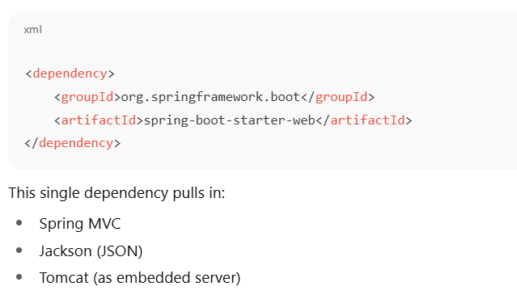
Spring Boot Starters

Slide 35
Spring boot Starters
📦 Common Spring Boot Starters
🔑 Core Starters
spring-boot-starter → Core starter, includes auto-configuration support and logging.
spring-boot-starter-logging → Brings in Logback, SLF4J.
⚡ Web Starters
spring-boot-starter-web → Build REST APIs and web apps (Spring MVC, Jackson, Tomcat).
spring-boot-starter-webflux → Reactive web apps (Spring WebFlux + Netty).

Slide 36
Spring boot Starters
🗄️ Data Access Starters
spring-boot-starter-data-jpa → JPA with Hibernate + Spring Data.
spring-boot-starter-jdbc → JDBC with HikariCP connection pooling.
spring-boot-starter-data-mongodb → MongoDB support.
spring-boot-starter-data-redis → Redis key-value store.
spring-boot-starter-data-cassandra → Cassandra NoSQL DB.
spring-boot-starter-data-elasticsearch → Elasticsearch integration.

Slide 37
Spring boot Starters
🔐 Security & Auth
spring-boot-starter-security → Spring Security, authentication, authorization.
spring-boot-starter-oauth2-client → OAuth2 client apps.
spring-boot-starter-oauth2-resource-server → Resource server with JWT tokens.

Slide 38
Spring boot Starters
📬 Messaging
spring-boot-starter-amqp → RabbitMQ support.
spring-boot-starter-kafka → Apache Kafka integration.

Slide 39
Spring boot Starters
🎨 Templating Engines
spring-boot-starter-thymeleaf → Thymeleaf template engine.
spring-boot-starter-mustache → Mustache templates.
spring-boot-starter-freemarker → FreeMarker support.

Slide 40
Spring boot Starters
🧪 Testing
spring-boot-starter-test → JUnit, Mockito, AssertJ, Spring Test, JSONassert, Hamcrest.
⚙️ Monitoring & Tools
spring-boot-starter-actuator → Health checks, metrics, info, monitoring endpoints.
spring-boot-devtools → Hot reload and dev-time features.

Slide 41
Spring boot Starter
The main responsibility of Spring Boot Starter is to combine a group of common or related dependencies into single dependencies.
For instance, we would like to develop a Spring WebApplication with Tomcat WebServer.
Then we need to add the following minimal jar dependencies in your Maven’s pom.xml file or Gradle’s build.gradle file
Spring core Jar file(spring-core-xx.jar)
Spring Web Jar file(spring-web-xx.jar)
Spring Web MVC Jar file(spring-webmvc-xx.jar)
Servlet Jar file(servlet-xx.jar)

Slide 42
Spring boot Starter
If we want to add some database, then we need to add database related jars like Spring JDBC jar file, Spring ORM jar files,Spring Transaction Jar file etc.
Spring JDBC Jar file(spring-jdbc-xx.jar)
Spring ORM Jar file(spring-orm-xx.jar)
Spring Transaction Jar file(spring-transaction-xx.jar)

Slide 43
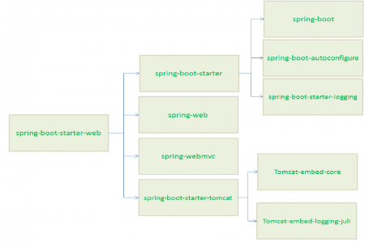
Spring boot Starter

Slide 44
Spring Boot CLI
To work with Spring boot CLI, first we need to install it in our system. There are many ways to install Spring boot CLI. 1. Manual installation 2. Installation with SDKMAN! 3. OSX Homebrew installation 4. MacPorts installation 5. Command-line completion

Slide 45
Spring Boot CLI
Spring boot CLI using manual installation in my Windows 7 OS. Find the below steps. Step 1: Download Spring boot CLI using below link spring-boot-cli-{version}.RELEASE-bin.zip. Step 2: Unzip it and keep somewhere in your system. Suppose I have kept it as follows. C:\spring-1.4.3.RELEASE Now we need to set following environment variables in our system. 1. SPRING_HOME with the value C:\spring-1.4.3.RELEASE 2. PATH with the value C:\spring-1.4.3.RELEASE\bin Step 3: Now we will test our installation. Open the command prompt and type the command spring

Slide 46
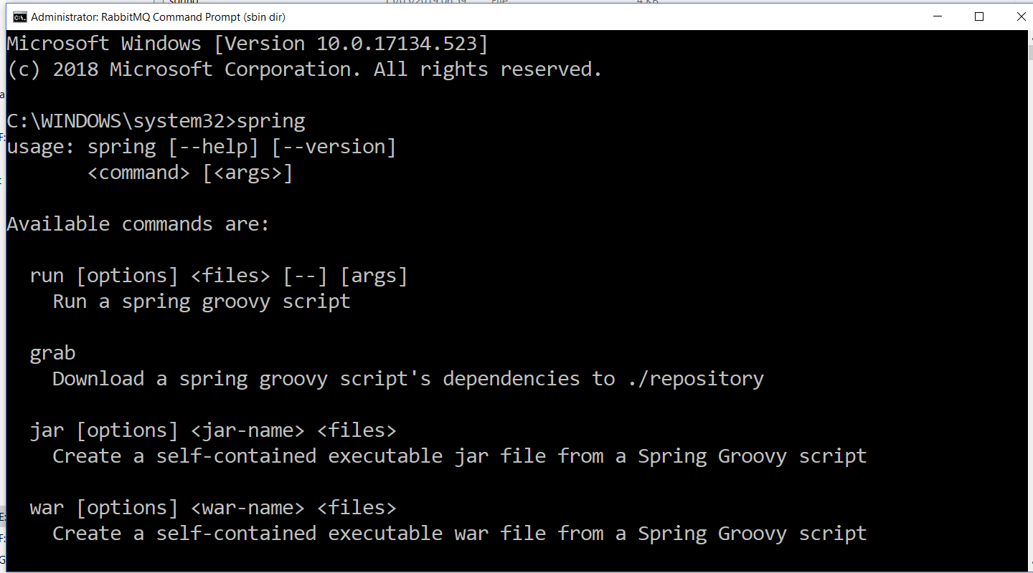
Spring Boot CLI

Slide 47
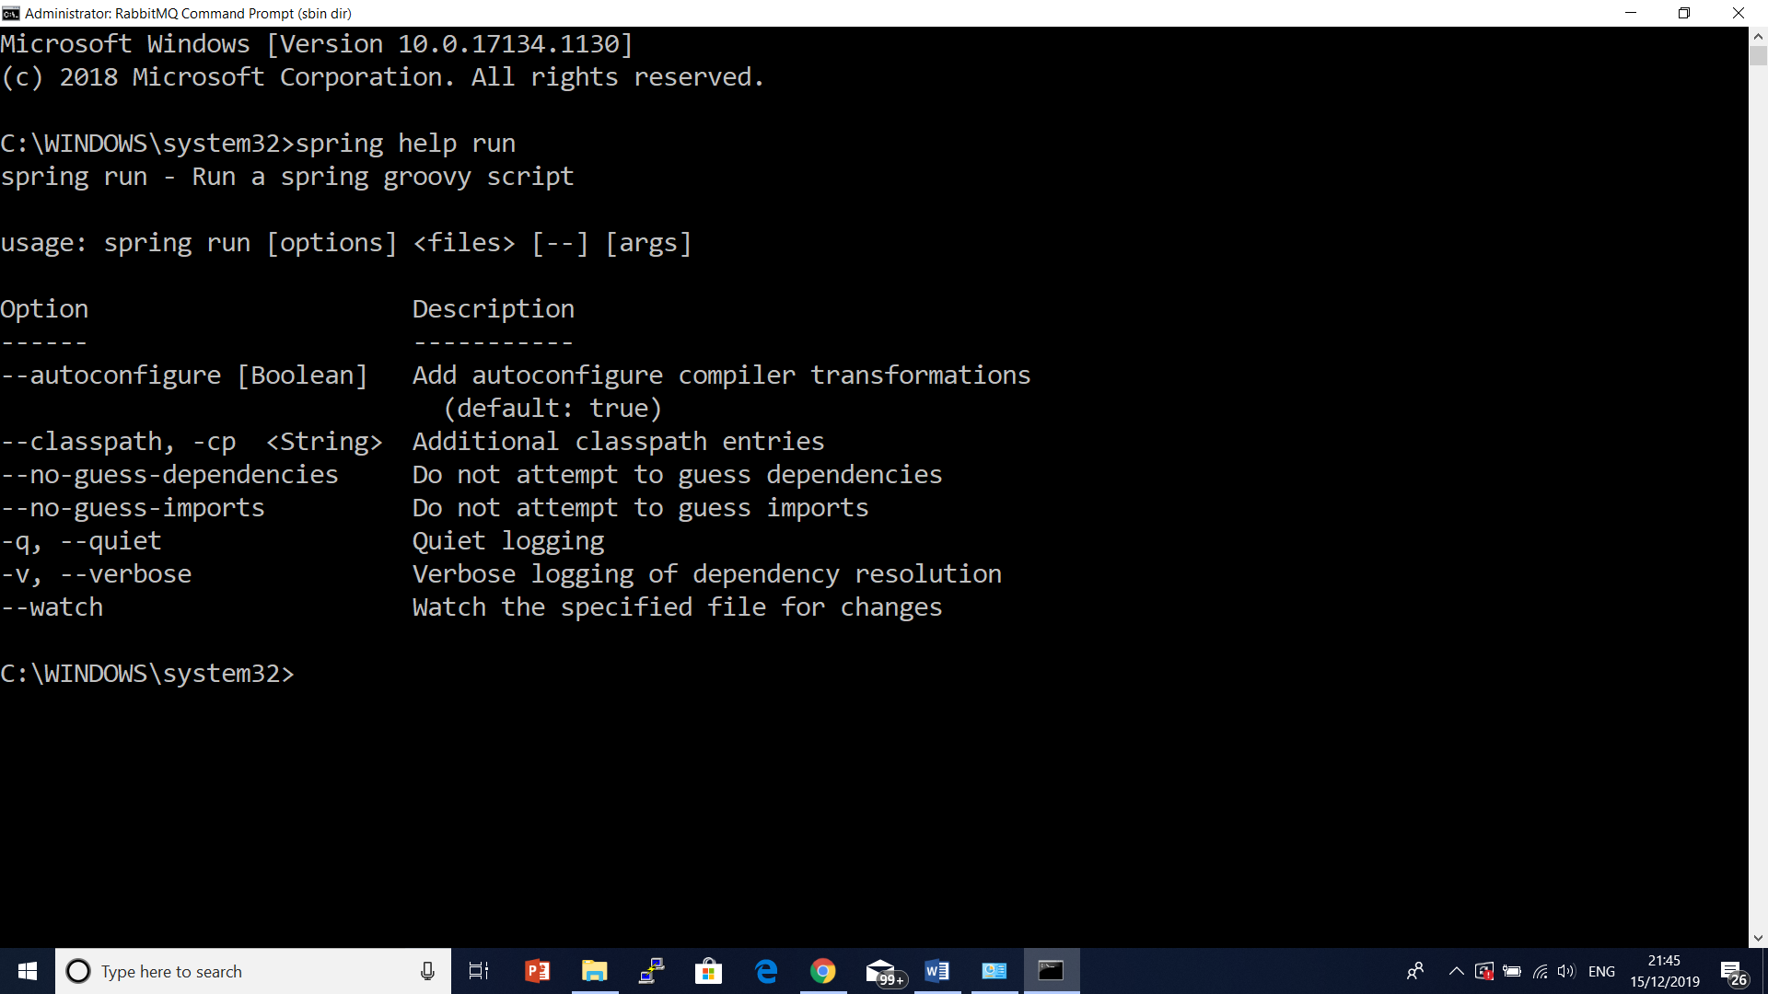
Spring Boot CLI

Slide 48
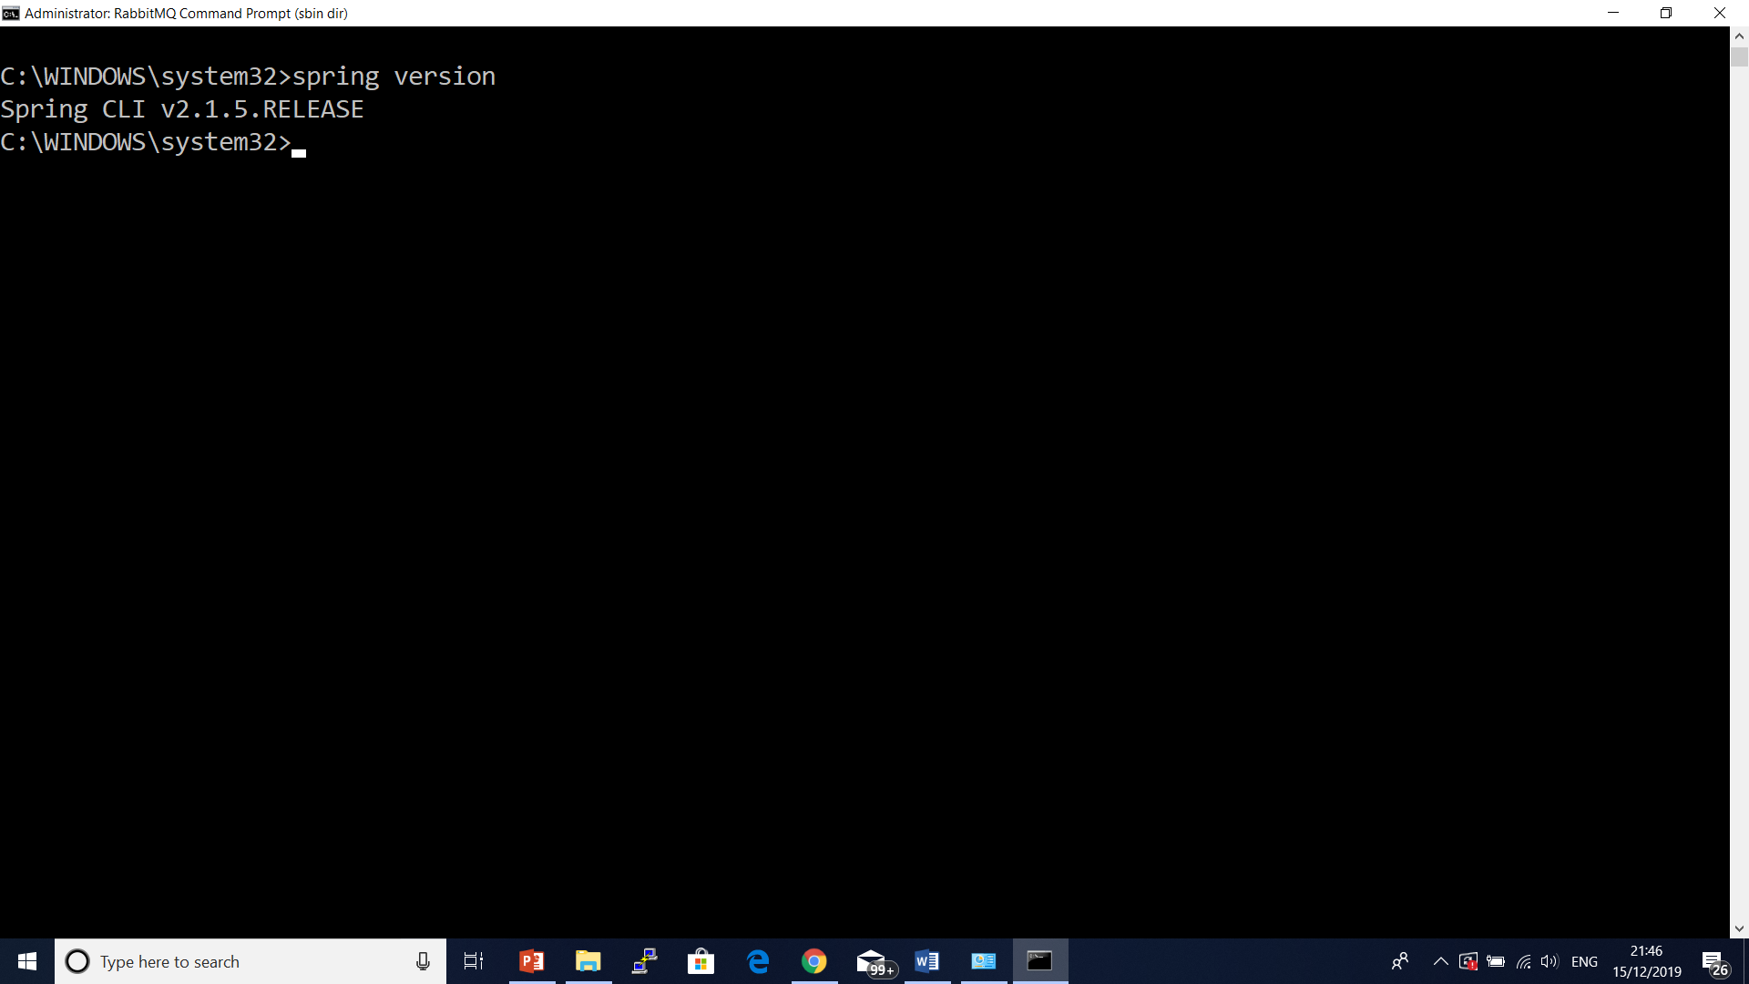
Spring Boot CLI

Slide 49
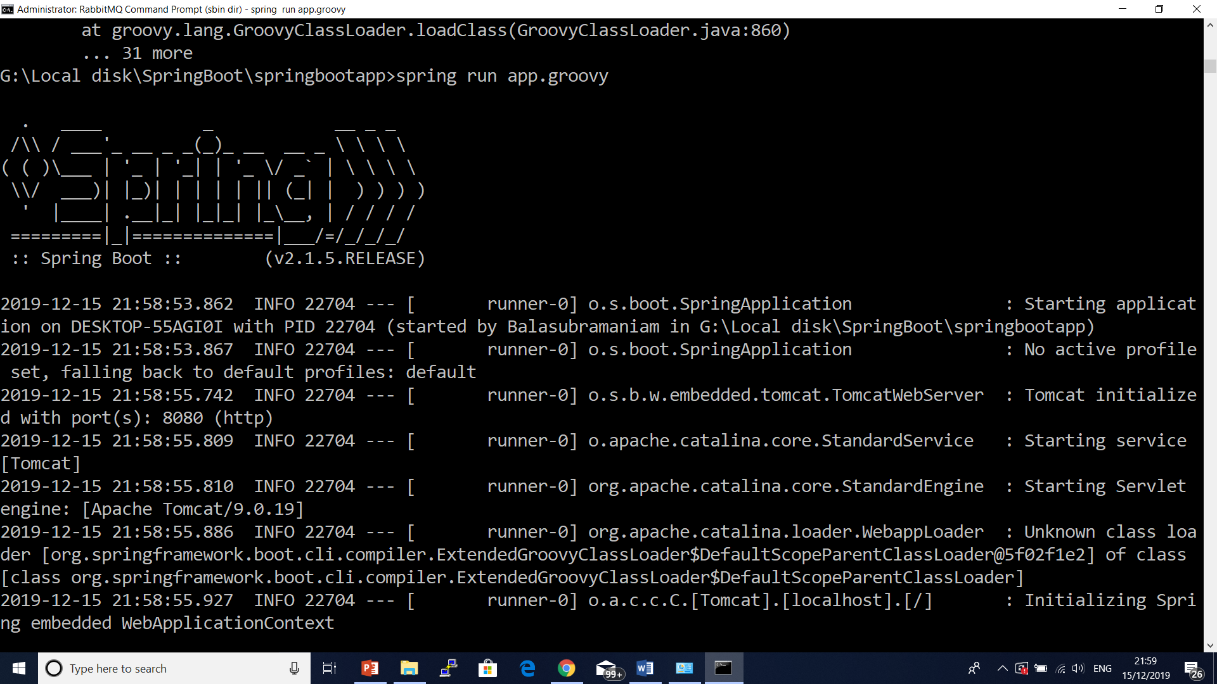
Spring Boot CLI

Slide 50

Spring Boot CLI

Slide 51

Spring Boot CLI

Slide 52
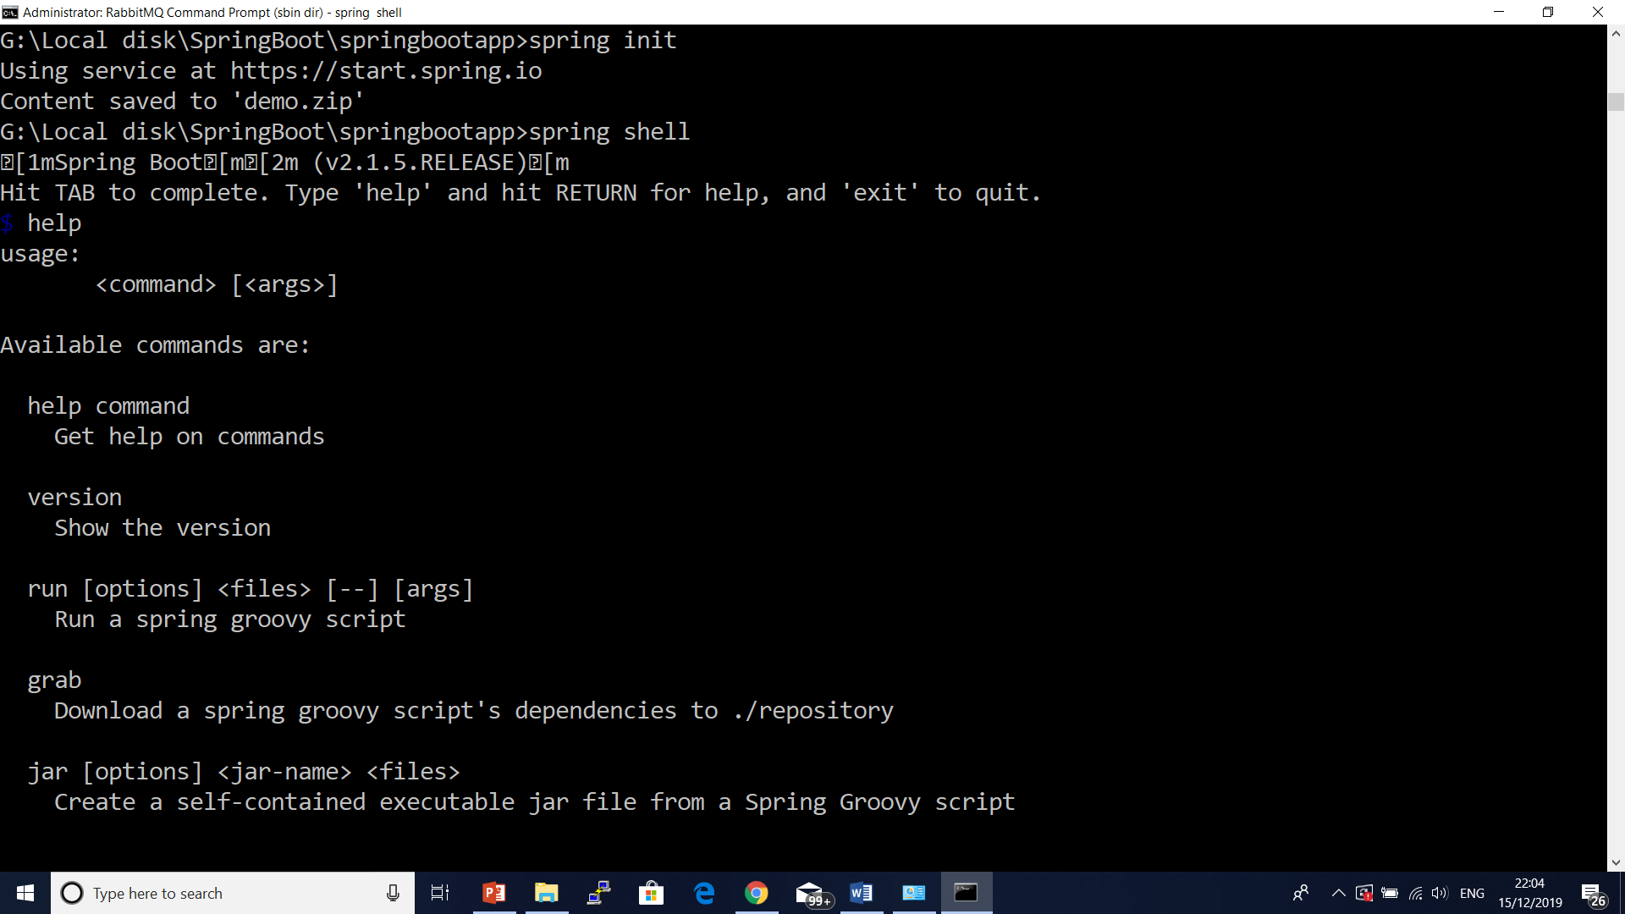
Spring Boot CLI

Slide 53
Spring Boot CLI
Create a New Project using Spring Boot CLI
spring init --dependencies=web,thymeleaf my-app.zip
In case we want to use Gradle build tool that will build a WAR file with any specific java version then we can run the command as follows.
spring init --build=gradle --java-version=1.8 --dependencies=web,thymeleaf --packaging=war my-app.zip
spring init --build=gradle --java-version=1.8 --dependencies=web,thymeleaf --packaging=war –group=com.nec –artifactId=testapi my-app.zip

Slide 54
Using Embedded Shell
Spring boot has command line completion scripts for BASH and Zsh shells. If we are using WINDOWS, spring boot provides shell command to launch an integrated shell. If using WINDOWS then launch integrated shell using the following command.
spring shell
Now we can directly run command without using spring keyword such as
$ version
$ test hello.groovy tests.groovy
$ run hello.groovy

Slide 55
Spring boot 2.x Features
Feature / Area | Spring Boot 1.x | Spring Boot 2.x
Base Framework | Spring Framework 4.x | Spring Framework 5.x
Java Version | Java 6/7/8 (baseline Java 7/8) | Java 8+ required (later 2.5/2.7 moved to Java 11+)
Reactive Support | ❌ Not available | ✅ Spring WebFlux (reactive, non-blocking, Netty-based)
Embedded Servers | Tomcat 7/8, Jetty 9, Undertow 1.x | Tomcat 8.5/9, Jetty 9.4, Undertow 2.x, HTTP/2 support
Default Connection Pool | Tomcat JDBC Pool | ✅ HikariCP (faster, lighter, better defaults)
Actuator | Basic endpoints (/health, /metrics, /info), not secure by default | ✅ Major redesign: /actuator/* namespace, secure by default, fine-grained config

Slide 56
Spring boot 2.x Features
Metrics | Codahale Metrics (Dropwizard) | ✅ Micrometer (vendor-neutral, supports Prometheus, Datadog, New Relic, CloudWatch, etc.)
Configuration | application.properties (YAML supported, but less flexible) | ✅ Strong YAML support, relaxed binding, profile-specific application-*.yml
Security | Basic Spring Security, endpoints open unless explicitly secured | ✅ Spring Security 5 integration, OAuth2, password encoder defaults to bcrypt, Actuator endpoints secured by default
Testing | JUnit 4, Spring Test | ✅ JUnit 5 (Jupiter) support, test slices (@WebMvcTest, @DataJpaTest, etc.)

Slide 57
Spring boot 2.x Features
Kotlin Support | Minimal, unofficial | ✅ First-class support, spring-boot-starter-kotlin, coroutines + WebFlux integration
DevTools | Basic auto-restart | ✅ Improved hot reload, better IDE integration, LiveReload
Cloud Readiness | Limited | ✅ Health groups (readiness/liveness probes), cloud-native integrations (K8s, CF)
Gradle Plugin | Groovy DSL only | ✅ Rewritten in Kotlin DSL (modern Gradle builds)
Data Access | Hibernate 4.x/5.0, traditional blocking drivers | ✅ Hibernate 5.x baseline, plus reactive data access (MongoDB, Cassandra, Redis)

Slide 58
Key Takeaways
Spring Boot 1.x → First generation, simplified Spring app creation, but limited in monitoring, security, and reactive support.
Spring Boot 2.x → Production-grade, cloud-ready, modernized (Micrometer, WebFlux, HikariCP, secure defaults, JUnit 5, Kotlin support).

Slide 59
Spring Boot 3.x Features
Feature / Area | Spring Boot 2.x | Spring Boot 3.x
Base Framework | Spring Framework 5.x | ✅ Spring Framework 6.x
Jakarta EE / Java EE | Uses javax.* namespace (Servlet, JPA, etc.) | ✅ Migrated to jakarta.* namespace (breaking change for all EE APIs)
Java Version | Java 8+ (2.0–2.4), Java 11+ (2.5+), Java 17 optional | ✅ Java 17+ required (LTS baseline), supports Java 21
GraalVM Native Images | Limited, experimental with Spring Native | ✅ First-class AOT + Native image support (via Spring AOT, no extra project)
Reactive Support (WebFlux) | Fully supported (Project Reactor) | ✅ Still supported, optimized for native & virtual threads
Embedded Servers | Tomcat 8.5/9, Jetty 9.4, Undertow 2.x, HTTP/2 | ✅ Tomcat 10.1, Jetty 11, Undertow 2.3 (Jakarta EE 10 compatible), HTTP/3 under development
Actuator + Micrometer | Micrometer-based, Prometheus/Datadog/etc. supported | ✅ Enhanced Micrometer, Micrometer Tracing (OpenTelemetry-based) for distributed tracing

Slide 60
Spring Boot 3.x Features
Observability | Metrics + logging (via Micrometer + Actuator) | ✅ Unified Observability: Metrics + Tracing + Logging → integrates with OTel
Security | Spring Security 5.x (OAuth2, JWT, LDAP) | ✅ Spring Security 6.x, stronger defaults, SecurityFilterChain over WebSecurityConfigurerAdapter
Testing | JUnit 5 (Jupiter), Mockito, AssertJ | ✅ Enhanced test slices, Native testing support, Testcontainers integration improvements
Kotlin | Kotlin 1.3–1.7 supported | ✅ Kotlin 1.7+ required, coroutine optimizations
Configuration | application.properties / application.yml, relaxed binding | ✅ Still supported, plus improved AOT processing for configs

Slide 61
Spring Boot 3.x Features
Deprecations | Legacy javax.* APIs still valid | ❌ Removed all javax.* → must migrate to jakarta.* (e.g., javax.persistence.* → jakarta.persistence.*)
DevTools | Auto-reload, LiveReload, IDE support | ✅ Still supported, faster reload with AOT hints
Cloud Readiness | Health groups, readiness/liveness probes | ✅ Better K8s integration, Observability with OTel, AWS/GCP starters updated

Slide 62
Key Changes in Spring Boot 3.x
🚀 Key Changes in Spring Boot 3.x
Java 17+ baseline – No Java 8/11 support anymore.
Jakarta EE 10 migration – All javax.* → jakarta.*.
Example:
import javax.persistence.Entity; // ❌ 2.x import jakarta.persistence.Entity; // ✅ 3.x
AOT + Native – Out-of-the-box support for GraalVM Native Images (faster startup, lower memory).
Observability – Metrics, logs, and traces unified under Micrometer + OpenTelemetry.
Spring Security 6 – New configuration style (no WebSecurityConfigurerAdapter).
Updated ecosystem – Hibernate 6, Tomcat 10.1, Jetty 11, Undertow 2.3, Jackson 2.14+, Micrometer 1.10+, etc.

Slide 63
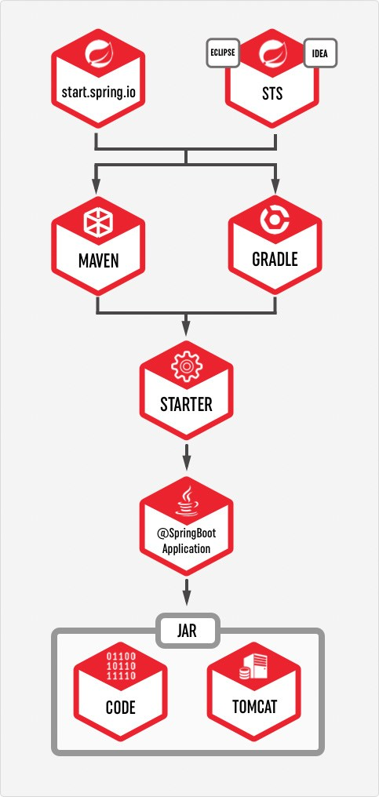
How to use Spring Boot

Slide 64
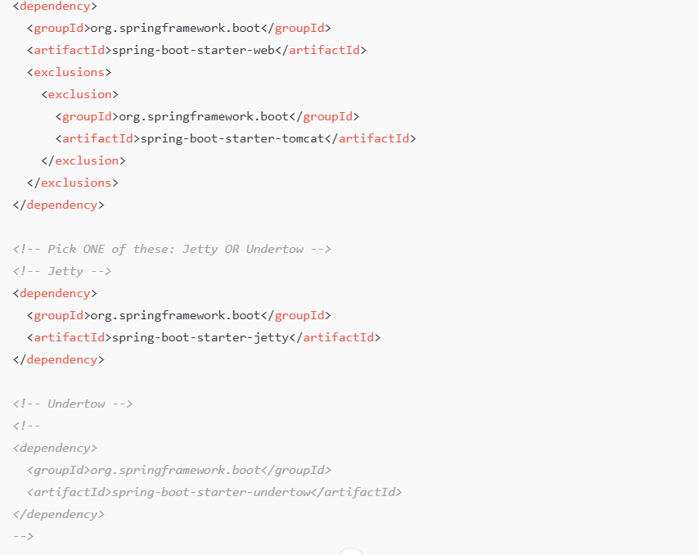
Customize Embedded Server - Jetty server

Slide 65
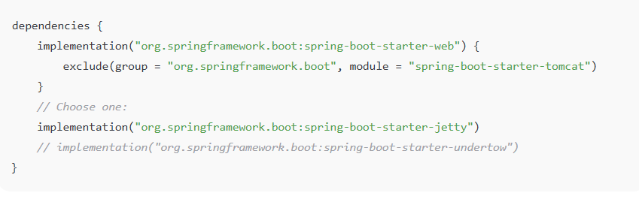
Customize Embedded Server - Jetty server

Slide 66
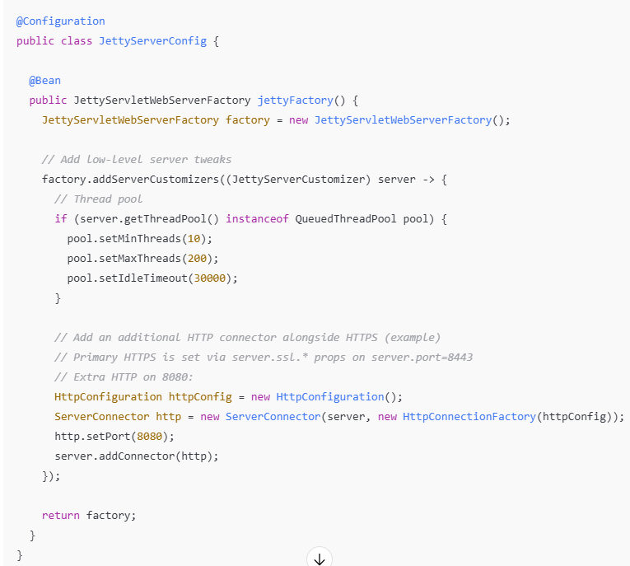
Programmatic customization- Jetty server

Slide 67
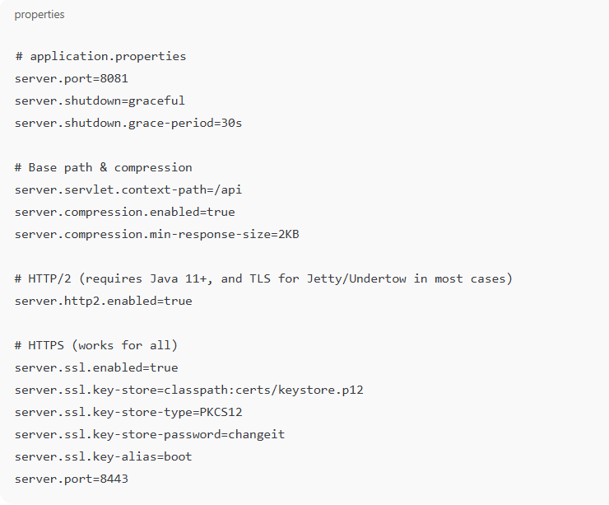
Spring Boot 2.0 Configuration

Slide 68
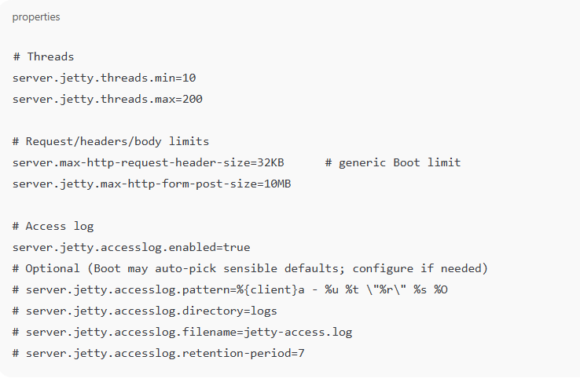
Jetty – properties & programmatic tuning

Slide 69
HTTPS Configuration
Create your own self signed SSL certificate
To get SSL digital certificate for our application we have two options –
to create a self-signed certificate
to obtain SSL certificate from certification authority(CA) we call it CA certificate.

Slide 70
HTTPS Configuration
keytool -genkey -alias selfsigned_localhost_sslserver -keyalg RSA -keysize 2048 -validity 700 -keypass changeit -storepass changeit -keystore ssl-server.jks.
To view what is inside this keystore we can again use the keytool -list command as bellow.
keytool -list -keystore ssl-server.jks

Slide 71
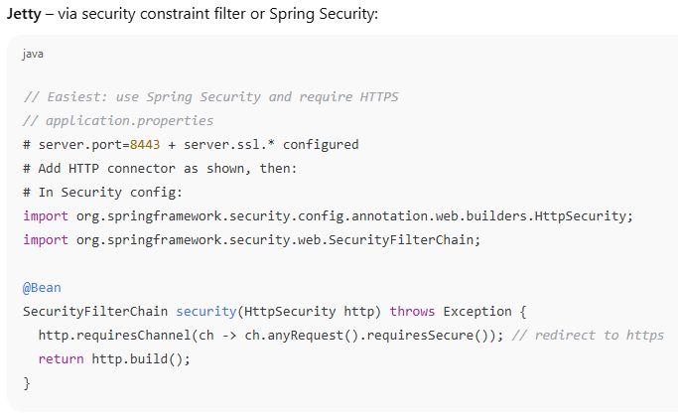
Force HTTP ➜ HTTPS redirect (Jetty & Undertow)

Slide 72
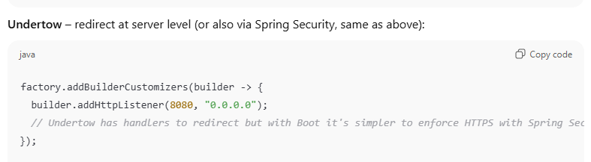
Force HTTP ➜ HTTPS redirect (Jetty & Undertow)

Slide 73
Quick basics (SLF4J + Logback)
Spring Boot uses SLF4J API with Logback by default.
Log levels:
TRACE < DEBUG < INFO < WARN < ERROR.
Configure via application.properties or logback-spring.xml

Slide 74
Logging
logging.level.org.springframework=DEBUG
logging.level.com.howtodoinjava=DEBUG
#output to a temp_folder/file
logging.file=${java.io.tmpdir}/application.log
# Logging pattern for the console
logging.pattern.console= %d{yyyy-MM-dd HH:mm:ss} - %msg%n
# Logging pattern for file
logging.pattern.file= %d{yyyy-MM-dd HH:mm:ss} [%thread] %-5level %logger{36} - %msg%

Slide 75
🚀 What is Spring Boot Actuator?
A production-ready module that exposes application insights via REST or JMX endpoints.
Provides health checks, metrics, logs, environment info, thread dumps, and more.
Designed to integrate with monitoring systems like Prometheus, Grafana, ELK/EFK, Zipkin/Jaeger.
Can be customized to expose exactly what you need.

Slide 76
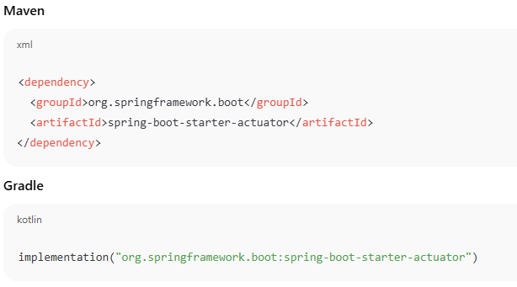
🚀 Adding Actuator

Slide 77
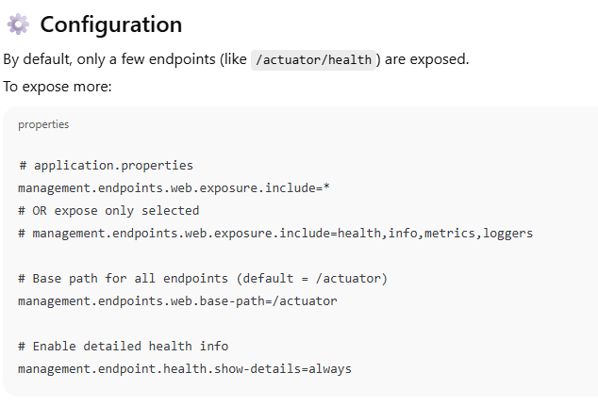
🚀 Adding Actuator

Slide 78
Key Actuator Endpoints
Endpoint | Description
/actuator | Lists all available endpoints
/actuator/health | Health of the app (up/down). Customizable with DB, disk, Kafka checks
/actuator/info | Application metadata (from application.properties or Git)
/actuator/metrics | Application metrics (JVM, memory, CPU, HTTP requests, DB, cache)
/actuator/loggers | View/change log levels at runtime
/actuator/env | Environment properties, system vars, config
/actuator/beans | Beans loaded in Spring context
/actuator/mappings | All available request mappings (URLs)
/actuator/threaddump | JVM thread dump
/actuator/heapdump | Heap dump (download)
/actuator/scheduledtasks | Scheduled jobs
/actuator/caches | Cache statistics
/actuator/shutdown | Graceful shutdown (needs explicit enable)

Slide 79
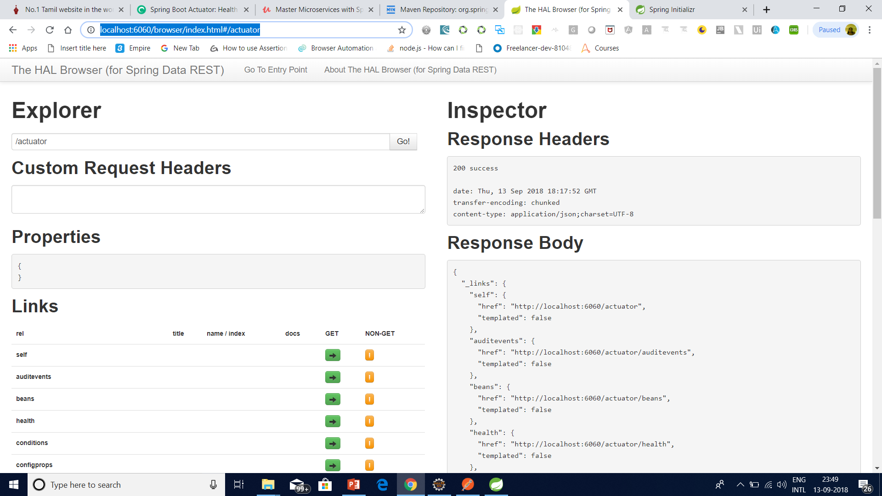
The Actuator – spring –data-hal-browser http://localhost:6060/browser/index.html

Slide 80
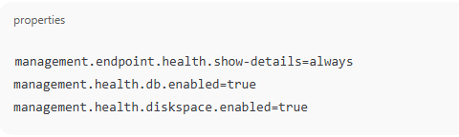
Health Indicators
Spring Boot Actuator integrates with health indicators:
Database: DataSourceHealthIndicator
Disk space: DiskSpaceHealthIndicator
Redis, Kafka, RabbitMQ, Elasticsearch, etc.

Slide 81
Health Indicators
Spring Boot Actuator integrates with health indicators:
Database: DataSourceHealthIndicator
Disk space: DiskSpaceHealthIndicator
Redis, Kafka, RabbitMQ, Elasticsearch, etc.

Slide 82
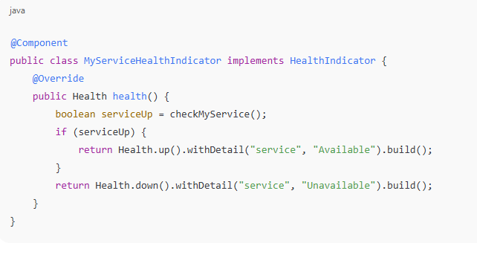
Health Indicators

Slide 83
Metrics
Powered by Micrometer, Actuator collects metrics like:
JVM memory, GC
CPU usage
Threads
HTTP request counts, latency
DB connection pool stats
Custom business metrics

Slide 84
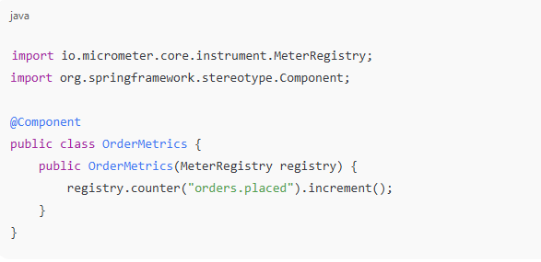
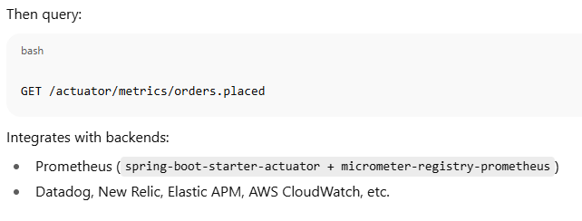
Metrics

Slide 85
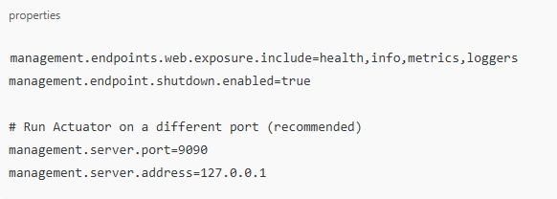
Security
By default, Actuator endpoints should be secured:

Slide 86
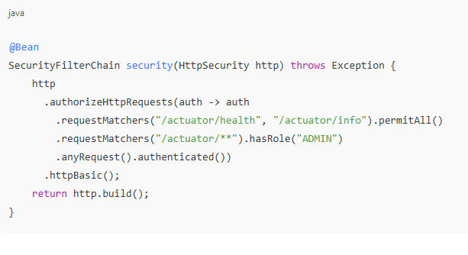
Security

Slide 87
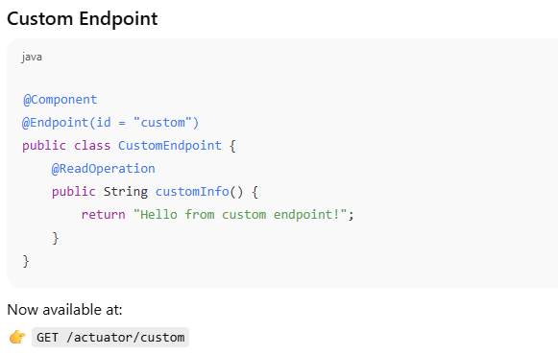
Security

Slide 88
Spring Cache
🚀 What is Spring Boot Caching?
Declarative caching using annotations (@Cacheable, @CachePut, @CacheEvict).
Pluggable backends: ConcurrentHashMap (default), EhCache, Hazelcast, Caffeine, Redis, etc.
Automatic integration via spring-boot-starter-cache.
Supports synchronous & asynchronous caching.

Slide 89
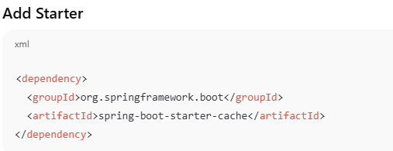
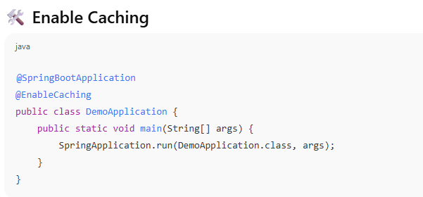
Spring Cache Setup

Slide 90
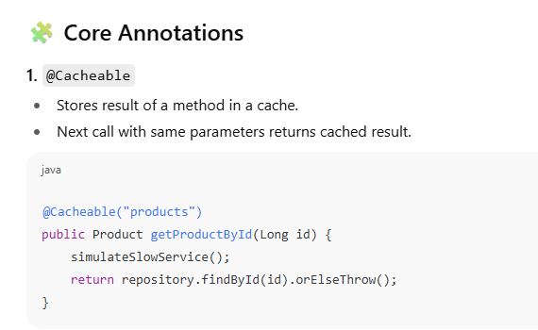
Spring Cache Setup

Slide 91
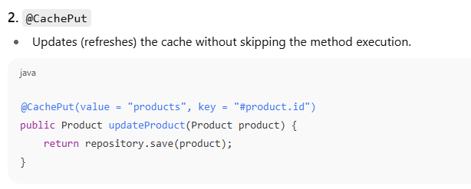
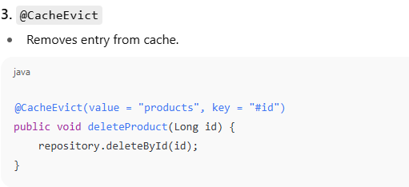
Spring Cache Setup

Slide 92
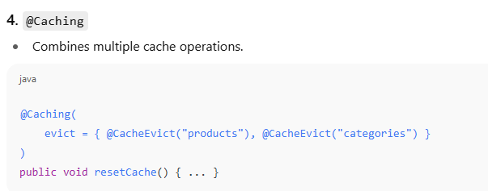
Spring Cache Setup

Slide 93
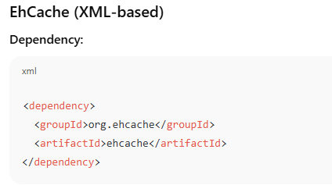
Supported cache providers in Spring
🔑 Cache ProvidersIn-Memory (default)
Uses ConcurrentHashMap (simple, dev-only).
No extra dependency needed.

Slide 94
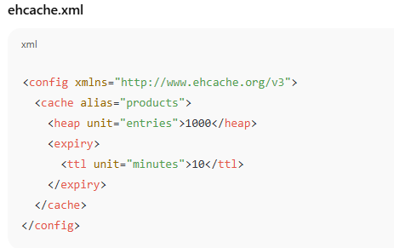
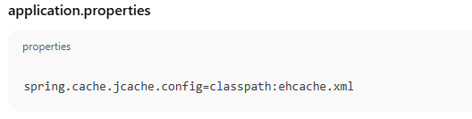
Supported cache providers in Spring

Slide 95
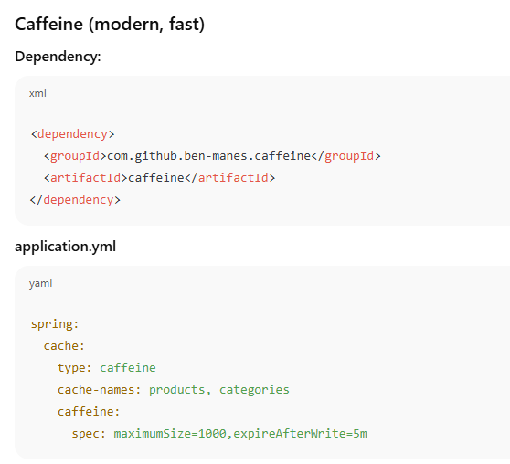
Supported cache providers in Spring

Slide 96
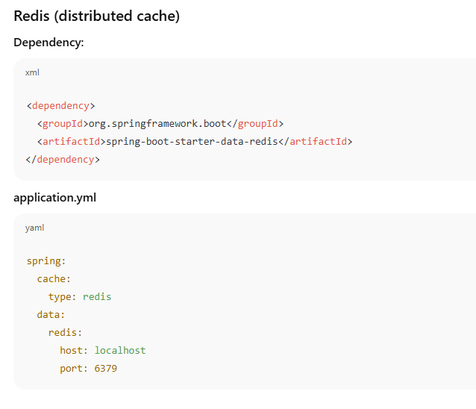
Supported cache providers in Spring

Slide 97
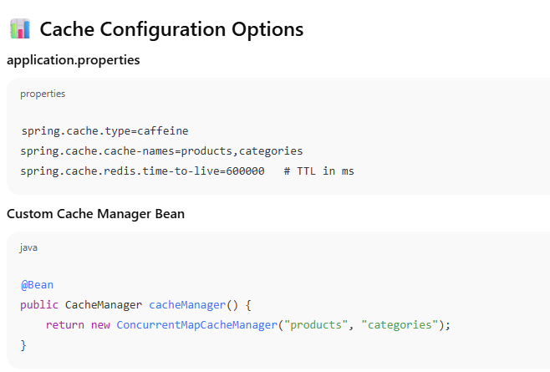
Supported cache providers in Spring

Slide 98
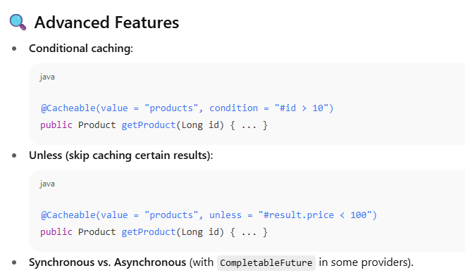
Supported cache providers in Spring

Slide 99
Supported cache providers in Spring
✅ Best Practices
Use Caffeine for local, high-performance caching.
Use Redis for distributed, multi-instance caching.
Always set TTL (time-to-live) to avoid stale data.
Monitor caches via Actuator → /actuator/caches.
Combine with Spring Security carefully (don’t cache user-sensitive data unless scoped).
Use cache key strategies (e.g., #id, #root.methodName) to avoid collisions.

Slide 100
Profile
application-dev.properties
application-qa.properties
application-stage.properties
application-prod.properties
At the time of launching the Java application
-Dspring.profiles.active=qa - in the VM properties, OR
Do the following in the application.properties file
spring.application.profiles=qa.

Slide 101
Externalized Configuration application.properties and YAML
🌟 What is Externalized Configuration?
In Spring Boot, configuration is pulled out of code and placed in external files so the same app can run in multiple environments (dev, test, prod) without recompiling.
Supported sources (in order of precedence):
Command-line args
Environment variables
application-{profile}.yml / application-{profile}.properties
application.yml or application.properties (default)
Default values in code (@Value, @ConfigurationProperties)

Slide 102
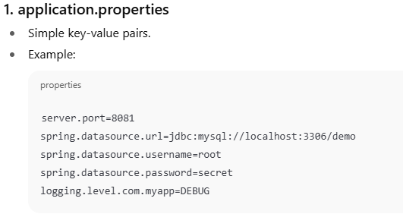
Configuration File Types

Slide 103
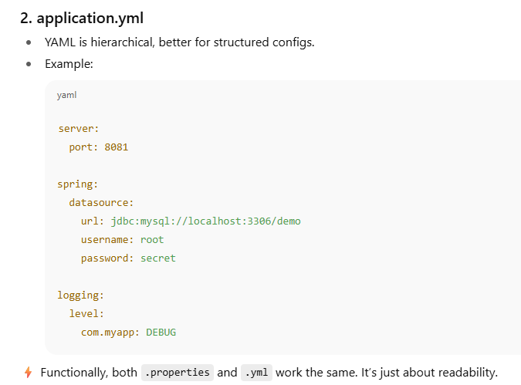
Configuration File Types

Slide 104

Profile-specific Configuration

Slide 105

Profile-specific Configuration

Slide 106

Accessing Config in Code

Slide 107

Accessing Config in Code
app.name=MyDemoApp
app.timeout=5000

Slide 108


Accessing Config in Code

Slide 109

Accessing Config in Code

Slide 110
@Value vs @ConfigurationProperties
Aspect | @Value | @ConfigurationProperties
Use case | Inject individual properties | Bind group of related properties
Type safety | Limited (string conversion) | Strong (POJO binding, validation)
Nested properties | ❌ Hard to manage | ✅ Easy with nested classes
Default values | ✅ via SpEL or : syntax | ✅ via field defaults
Validation | ❌ Not directly supported | ✅ Supports JSR-303 validation
Maintainability | Messy with many props | Clean and organized

Slide 111
Spring Boot Configuration
✅ Best Practices
Prefer YAML for complex configs (readable, hierarchical).
Use profiles for environment separation (dev/test/prod).
Never hardcode passwords → use env vars or secret managers.
Document configs with @ConfigurationProperties (bind strongly typed objects).
Use Actuator → /actuator/env to inspect loaded configs at runtime.

Slide 112

Choose DB from multiple schema

Slide 113

Choose DB from multiple schema

Slide 114
Annotations
OracleConfiguration will only be loaded if the class DataSource is present, in which case we can assume the application will use a database:
@Configuration
@ConditionalOnClass(DataSource.class)
class OracleAutoconfiguration {
//...
}
This bean to be created if a bean called dataSource is present and if a bean called entityManagerFactory is not already defined:
@Bean
@ConditionalOnBean(name = "dataSource")
LocalContainerEntityManagerFactoryBean entityManagerFactory() {
// ...
}

Slide 115
Annotations
transactionManager bean that will only be loaded if a bean of type JpaTransactionManager is not already defined:
@Bean
@ConditionalOnMissingBean(type = "JpaTransactionManager")
JpaTransactionManager transactionManager(EntityManagerFactory entityManagerFactory) {
JpaTransactionManager transactionManager = new JpaTransactionManager();
transactionManager.setEntityManagerFactory(entityManagerFactory);
return transactionManager;
}

Slide 116
Annotations
@Bean
@ConditionalOnProperty(
name = "usemysql",
havingValue = "local"
)
DataSource dataSource() {
// ...
}

Slide 117
Annotations
@ConditionalOnResource(resources = "classpath:mysql.properties")
Properties additionalProperties() {
// ...
}
@Bean
@ConditionalOnExpression("${usemysql} && ${mysqlserver == 'local'}")
DataSource dataSource() {
// ...
}

Slide 118
Annotations
@Conditional(HibernateCondition.class)
Properties additionalProperties() {
//...
}

Slide 119
What is Pivotal
Vmware and EMC spin out
• vFabric from vmware
• Greenplum MPP DB and Hadoop from EMC
• Agile development acquisitions Pivotal Labs and Xtreme Labs
Paul Maritz CEO
• Former CEO vmware.
Custodian of various OSS projects including Spring
• and RabbitMQ, Redis, CloudFondry, Groovy/Grails, …
Commercial interests in Big/Fast Data, PaaS, Enterprise tooling
• Spring is an enabling technology

Slide 120
Packaging For Production
Maven plugin (using spring-boot-starter-parent):
! Gradle plugin:
<plugin>
<groupId>org.springframework.boot</groupId>
<artifactId>spring-boot-maven-plugin</artifactId>
</plugin>
$ mvn package
apply plugin: 'spring-boot'
$ gradle build

Slide 121
Packaging For Production
Packaging For Production
$ java -jar yourapp.jar
! Easy to understand structure
! No unpacking or start scripts required
! Typical REST app ~10Mb
! Cloud Foundry friendly (works & fast to upload)

Slide 122


Slide 123


Slide 124
How to Deploy Spring Boot Application to Cloud Foundry Platform
Cloud Foundry is an open-source platform as a service (PaaS) that provides you with a choice of clouds, developer frameworks, and application services.
It is open source and it is governed by the Cloud Foundry Foundation.
The original Cloud Foundry was developed by VMware and currently it is managed by Pivotal, a joint venture company by GE, EMC and VMware.

Slide 125
Cloud Foundary Providers
Pivotal Cloud Foundry
IBM Bluemix
HPE Helion Stackato 4.0
Atos Canopy
CenturyLink App Fog
GE Predix
Huawei FusionStage
SAP Cloud Platform
Swisscom Application Cloud

Slide 126
Cloud Foundry Installation for Windows
Download the CF Windows installer. It will prompt for the download. Save the zip file distribution.
Unpack the zip file to a suitable place in your workstation.
After successfully unzip operation, double cick on the cf CLI executable.
When prompted, click Install, then Close.

Slide 127
Cloud Foundry Installation for Windows
Verify the installation by opening a terminal window and type cf. If your installation was successful, the cf CLI help listing appears.
This indicates that you are ready to go with any cloud foundry platform from your local workstation.

Slide 128


Slide 129


Slide 130


Slide 131
Login and logout from PWS Console using CLI
Login to PWS – We will use cf login -a api.run.pivotal.io
Logout from PWS Console – We will use command cf logout to logout from the platform, once we have all the work done for that session.

Slide 132


Slide 133


Slide 134


Slide 135


Slide 136


Slide 137

Heroku

Slide 138


Slide 139


Slide 140


Slide 141


Slide 142


Slide 143
Using the Heroku Deploy CLI plugin
heroku addons:create heroku-postgresql:hobby-dev
heroku plugins:install heroku-cli-deploy
heroku create --no-remote
heroku deploy:jar target/my-app.jar --app sushi

Slide 144
Internationalization

Slide 145
Currently Available AutoConfiguration Behaviour
Data grid: Spring Data Gemfire, Solr and Elasticsearch
! Websocket
! Web services
! Mobile & Social (Facebook, Twitter and LinkedIn)
! Reactor for events and async processing
! Jersey
! JTA
! Email, CRaSH, AOP (AspectJ)
! Actuator features (Security, Audit, Metrics, Trace)

Slide 146

Spring Boot Security

Slide 147

Spring Boot Security

Slide 148

Spring Boot Security

Slide 149

Spring Boot Security

Slide 150

. SECURING AN APPLICATION WITH SPRING BOOT AND SPRING SECURITY

Slide 151
EnableGlobalMethodSecurity vs Enable Web Security
EnableGlobalMethodSecurity provides AOP security on methods, some of annotation it will enable are PreAuthorize PostAuthorize

Slide 152


. SECURING AN APPLICATION WITH SPRING BOOT AND SPRING SECURITY

Slide 153

. SECURING AN APPLICATION WITH SPRING BOOT AND SPRING SECURITY

Slide 154
Reactive java programming
Reactive programming is a programming paradigm that promotes an asynchronous, non-blocking, event-driven approach to data processing.
Reactive programming involves modeling data and events as observable data streams and implementing data processing routines to react to the changes in those streams.

Slide 155

Blocking request processing

Slide 156

Non-blocking request processing

Slide 157
What is reactive programming?
The term, “reactive,” refers to programming models that are built around reacting to changes.
It is build around publisher-subscriber pattern (observer pattern).
In reactive style of programming, we make a request for resource and start performing other things.
When the data is available, we get the notification along with data inform of call back function.
In callback function, we handle the response as per application/user needs.

Slide 158
What is reactive programming?
One important thing to remember is back pressure.
In non-blocking code, it becomes important to control the rate of events so that a fast producer does not overwhelm its destination.
Reactive web programming is great for applications that have streaming data, and clients that consume it and stream it to their users.
It is not great for developing traditional CRUD applications.
If you’re developing the next Facebook or Twitter with lots of data, a reactive API might be just what you’re looking for.

Slide 159
Reactive Streams API
The new Reactive Streams API was created by engineers from Netflix, Pivotal, Lightbend, RedHat, Twitter, and Oracle, among others and is now part of Java 9.
It defines four interfaces:
Publisher: Emits a sequence of events to subscribers according to the demand received from its subscribers. A publisher can serve multiple subscribers.
It has a single method:
Publisher.java
public interface Publisher<T>
{
public void subscribe(Subscriber<? super T> s);
}

Slide 160
Reactive Streams API
Subscriber: Receives and processes events emitted by a Publisher. Please note that no notifications will be received until Subscription#request(long) is called to signal the demand.
It has four methods to handle various kind of responses received.
Subscriber.java
public interface Subscriber<T>
{
public void onSubscribe(Subscription s);
public void onNext(T t);
public void onError(Throwable t);
public void onComplete();
}

Slide 161
Reactive Streams API
Subscription: Defines a one-to-one relationship between a Publisher and a Subscriber. It can only be used once by a single Subscriber. It is used to both signal desire for data and cancel demand (and allow resource cleanup).
Subscription.java
public interface Subscription<T>
{
public void request(long n);
public void cancel();
}

Slide 162
Reactive Streams API
Processor: Represents a processing stage consisting of both a Subscriber and a Publisher and obeys the contracts of both.
Processor.java
public interface Processor<T, R> extends Subscriber<T>, Publisher<R>
{
}

Slide 163
Reactive Streams API
Two popular implementations of reactive streams are RxJava and Project Reactor

Slide 164
What is Spring WebFlux
Spring WebFlux is parallel version of Spring MVC and supports fully non-blocking reactive streams.
It support the back pressure concept and uses Netty as inbuilt server to run reactive applications.
If you are familiar with Spring MVC programming style, you can easily work on webflux also.
Spring webflux uses project reactor as reactive library. Reactor is a Reactive Streams library and, therefore, all of its operators support non-blocking back pressure. It is developed in close collaboration with Spring

Slide 165
Spring MVC vs WebFlux
Traditional Stack | Reactive Stack
Spring Web MVC | Spring WebFlux
Controller and Handler Mapping | Router Functions
Servlet API | HTTP/ Reactive Stream
Servlet Containers | Any servlet container with support for Servlet 3.1+, Tomcat 8.x,Jetty, Netty, UnderTow

Slide 166

Traditional

Slide 167

WebFlux

Slide 168
WebFlux
Reactive systems are responsive, meaning that they respond in a timely manner, in all possible circumstances. They focus on providing rapid and consistent response times, establishing reliable upper bounds so they deliver a consistent quality of service.

Slide 169
WebFlux
Reactive systems are resilient, meaning that they remain responsive in the face of failure. Resilience is achieved by the techniques of replication, containment, isolation, and delegation. By isolating application components from each other, you can contain failures and protect the system as a whole.

Slide 170
WebFlux
Reactive systems are elastic, meaning that they stay responsive under varying workloads. This is achieved by scaling application components elastically to meet the current demand.

Slide 171
WebFlux
Reactive systems are message-driven, meaning that they rely on asynchronous message passing between components. This allows you to create loose coupling, isolation, and location transparency.

Slide 172
Characteristics of a reactive system
Reactive systems are built by creating isolated components that communicate with one another asynchronously and can scale quickly to meet the current load. Components still fail in reactive systems, but there are defined actions to perform as a result of that failure, which keeps the system as a whole functional and responsive.

Slide 173
Characteristics of a reactive system
Data streams: A stream is a sequence of events ordered in time, such as user interactions, REST service calls, JMS messages, and results from a database.
Asynchronous: Data stream events are captured asynchronously and your code defines what to do when an event is emitted, when an error occurs, and when the stream of events has completed.

Slide 174
Characteristics of a reactive system
Non-blocking: As you process events, your code should not block and perform synchronous calls; instead, it should make asynchronous calls and respond as the results of those calls are returned.
Back pressure: Components control the number of events and how often they are emitted. In reactive terms, your component is referred to as the subscriber and events are emitted by a publisher. This is important because the subscriber is in control of how much data it receives and thus will not overburden itself.

Slide 175
Characteristics of a reactive system
Failure messages: Instead of components throwing exceptions, failures are sent as messages to a handler function. Whereas throwing exceptions breaks the stream, defining a function to handle failures as they occur does not.

Slide 176
The Reactive Streams API
The new Reactive Streams API was created by engineers from Netflix, Pivotal, Lightbend, RedHat, Twitter, and Oracle, among others. Published in 2015, the Reactive Streams API is now part of Java 9. It defines four interfaces:
Publisher: Emits a sequence of events to subscribers.
Subscriber: Receives and processes events emitted by a Publisher.
Subscription: Defines a one-to-one relationship between a Publisher and a Subscriber.
Processor: Represents a processing stage consisting of both a Subscriber and a Publisher and obeys the contracts of both.

Slide 177


Slide 178

Spring MVC vs WebFlux

Slide 183
Why Streams?
In software development, there can be cases where we need to handle the potentially large amount of data.
So while handling these kinds of scenarios there can be issues such as `out of memory` exceptions so we should divide the data in chunks and handle the chunks independently.

Slide 184
What is the Akka Framework?
Akka is a toolkit and runtime for building highly concurrent, distributed, and fault tolerant applications on the JVM.
Akka is written in Scala, with language bindings provided for both Scala and Java.
Akka’s approach to handling concurrency is based on the Actor Model.
In an actor-based system, everything is an actor, in much the same way that everything is an object in object-oriented design.
A key difference is that the Actor Model was specifically designed and architected to serve as a concurrent model whereas the object-oriented model is not.
More specifically, in a Scala actor system, actors interact and share information, without any presupposition of sequentiality.
The mechanism by which actors share information with one another, and task one another, is message passing.

Slide 185
What is the Akka Framework?
Akka creates a layer between the actors and the underlying system such that actors simply need to process messages.
All the complexity of creating and scheduling threads, receiving and dispatching messages, and handling race conditions and synchronization, is relegated to the framework to handle transparently.

Slide 186
What is the Akka Framework?
Akka strictly adheres to the Reactive Manifesto.
Reactive applications aim at replacing traditional multithreaded applications with an architecture that satisfies one or more of the following requirements:
Event-driven. Using Actors, one can write code that handles requests asynchronously and employs non-blocking operations exclusively.
Scalable. In Akka, adding nodes without having to modify the code is possible, thanks both to message passing and location transparency.

Slide 187
What is the Akka Framework?
Resilient. Any application will encounter errors and fail at some point in time. Akka provides “supervision” (fault tolerance) strategies to facilitate a self-healing system.
Responsive. Many of today’s high performance and rapid response applications need to give quick feedback to the user and therefore need to react to events in an extremely timely manner. Akka’s non-blocking, message-based strategy helps achieve this.

Slide 188
What is an Actor in Akka?
An actor is essentially nothing more than an object that receives messages and takes actions to handle them.
It is decoupled from the source of the message and its only responsibility is to properly recognize the type of message it has received and take action accordingly.

Slide 189
What is an Actor in Akka?
Upon receiving a message, an actor may take one or more of the following actions:
Execute some operations itself (such as performing calculations, persisting data, calling an external web service, and so on)
Forward the message, or a derived message, to another actor
Instantiate a new actor and forward the message to it.
Alternatively, the actor may choose to ignore the message entirely (i.e., it may choose inaction) if it deems it appropriate to do so.

Slide 190
The Actor System
Taking a complex problem and recursively splitting it into smaller sub-problems is a sound problem solving technique in general.
This approach can be particularly beneficial in computer science (consistent with the Single Responsibility Principle), as it tends to yield clean, modularized code, with little or no redundancy, that is relatively easy to maintain.

Slide 191
The Actor System
In an actor-based design, use of this technique facilitates the logical organization of actors into a hierarchical structure known as an Actor System.
The actor system provides the infrastructure through which actors interact with one another.

Slide 192

The Actor System

Slide 193
The Actor System
In Akka, the only way to communicate with an actor is through an ActorRef.
An ActorRef represents a reference to an actor that precludes other objects from directly accessing or manipulating that actor’s internals and state.
Messages may be sent to an actor via an ActorRef using one of the following syntax protocols:
! (“tell”) – sends the message and returns immediately
? (“ask”) – sends the message and returns a Future representing a possible reply

Slide 194
The Actor System
Each actor has a mailbox to which its incoming messages are delivered.
There are multiple mailbox implementations from which to choose, with the default implementation being FIFO.
An actor contains many instance variables to maintain state while processing multiple messages.
Akka ensures that each instance of an actor runs in its own lightweight thread and that messages are processed one at a time.
In this way, each actor’s state can be reliably maintained without the developer needing to explicitly worry about synchronization or race conditions.

Slide 195
The Actor System
Each actor is provided with the following useful information for performing its tasks via the Akka Actor API:
sender: an ActorRef to the sender of the message currently being processed
context: information and methods relating to the context within which the actor is running (includes, for example, an actorOf method for instantiating a new actor)
supervisionStrategy: defines the strategy to be used for recovering from errors
self: the ActorRef for the actor itself

Slide 196
Supervision
supervision describes a dependency relationship between actors: the supervisor delegates tasks to subordinates and therefore must respond to their failures.
When a subordinate detects a failure (i.e. throws an exception), it suspends itself and all its subordinates and sends a message to its supervisor, signaling failure.
Depending on the nature of the work to be supervised and the nature of the failure, the supervisor has a choice of the following four options:

Slide 197
Supervision
Resume the subordinate, keeping its accumulated internal state
Restart the subordinate, clearing out its accumulated internal state
Stop the subordinate permanently
Escalate the failure, thereby failing itself

Slide 198
What Restarting Means
When presented with an actor which failed while processing a certain message, causes for the failure fall into three categories:
Systematic (i.e. programming) error for the specific message received
(Transient) failure of some external resource used during processing the message
Corrupt internal state of the actor

Slide 199
What Restarting Means
suspend the actor (which means that it will not process normal messages until resumed), and recursively suspend all children
call the old instance’s preRestart hook (defaults to sending termination requests to all children and calling postStop)
wait for all children which were requested to terminate (using context.stop()) during preRestart to actually terminate; this—like all actor operations—is non-blocking, the termination notice from the last killed child will effect the progression to the next step
create new actor instance by invoking the originally provided factory again
invoke postRestart on the new instance (which by default also calls preStart)
send restart request to all children which were not killed in step 3; restarted children will follow the same process recursively, from step 2
resume the actor

Slide 200
The Actor System
Akka ensures that each instance of an actor runs in its own lightweight thread and that messages are processed one at a time.
In this way, each actor's state can be reliably maintained without the developer needing to explicitly worry about synchronization or race conditions.

Slide 201
Actor System
Actors are objects which encapsulate state and behavior, they communicate exclusively by exchanging messages which are placed into the recipient’s mailbox.
In a sense, actors are the most stringent form of object-oriented programming, but it serves better to view them as persons:
while modeling a solution with actors, envision a group of people and assign sub-tasks to them, arrange their functions into an organizational structure and think about how to escalate failure.
The result can then serve as a mental scaffolding for building the software implementation.

Slide 202
Akka System
An actor is a container for State, Behavior, a Mailbox, Child Actors and a Supervisor Strategy.
All of this is encapsulated behind an Actor Reference.
One noteworthy aspect is that actors have an explicit lifecycle, they are not automatically destroyed when no longer referenced;

Slide 203


Slide 205
Akka System
State
Actor objects will typically contain some variables which reflect possible states the actor may be in.
This can be an explicit state machine, or it could be a counter, set of listeners, pending requests, etc.
These data are what make an actor valuable, and they must be protected from corruption by other actors.
The good news is that Akka actors conceptually each have their own light-weight thread, which is completely shielded from the rest of the system.
This means that instead of having to synchronize access using locks you can write your actor code without worrying about concurrency at all.

Slide 206
Akka System
Behavior
Every time a message is processed, it is matched against the current behavior of the actor.
Behavior means a function which defines the actions to be taken in reaction to the message at that point in time, say forward a request if the client is authorized, deny it otherwise.
This behavior may change over time, e.g. because different clients obtain authorization over time, or because the actor may go into an “out-of-service” mode and later come back.
These changes are achieved by either encoding them in state variables which are read from the behavior logic, or the function itself may be swapped out at runtime, see the become and unbecome operations.

Slide 207
Akka System
Mailbox
An actor’s purpose is the processing of messages, and these messages were sent to the actor from other actors (or from outside the actor system).
The piece which connects sender and receiver is the actor’s mailbox: each actor has exactly one mailbox to which all senders enqueue their messages.
Enqueuing happens in the time-order of send operations, which means that messages sent from different actors may not have a defined order at runtime due to the apparent randomness of distributing actors across threads.
Sending multiple messages to the same target from the same actor, on the other hand, will enqueue them in the same order.

Slide 208
Akka System
Child Actors
Each actor is potentially a supervisor: if it creates children for delegating sub-tasks, it will automatically supervise them.
The list of children is maintained within the actor’s context and the actor has access to it.
Modifications to the list are done by creating (context.actorOf(...)) or stopping (context.stop(child)) children and these actions are reflected immediately.
The actual creation and termination actions happen behind the scenes in an asynchronous way, so they do not “block” their supervisor.

Slide 209
Akka System
Supervisor Strategy
The final piece of an actor is its strategy for handling faults of its children.
Fault handling is then done transparently by Akka, applying one of the strategies in Supervision and Monitoring for each incoming failure.
As this strategy is fundamental to how an actor system is structured, it cannot be changed once an actor has been created.

Slide 210
Akka System
When an Actor Terminates
Once an actor terminates, i.e. fails in a way which is not handled by a restart, stops itself or is stopped by its supervisor, it will free up its resources, draining all remaining messages from its mailbox into the system’s “dead letter mailbox” which will forward them to the EventStream as DeadLetters.
The mailbox is then replaced within the actor reference with a system mailbox, redirecting all new messages to the EventStream as DeadLetters.
This is done on a best effort basis, though, so do not rely on it in order to construct “guaranteed delivery”.

Slide 211
Akka System
Akka is a set of open-source libraries for designing scalable, resilient systems that span processor cores and networks.
Akka allows you to focus on meeting business needs instead of writing low-level code to provide reliable behavior, fault tolerance, and high performance.
Many common practices and accepted programming models do not address important challenges inherent in designing systems for modern computer architectures.

Slide 212
Akka System
To be successful, distributed systems must cope in an environment where components crash without responding, messages get lost without a trace on the wire, and network latency fluctuates.

Slide 213
Akka System
Akka provides:
Multi-threaded behavior without the use of low-level concurrency constructs like atomics or locks — relieving you from even thinking about memory visibility issues.
Transparent remote communication between systems and their components — relieving you from writing and maintaining difficult networking code.
A clustered, high-availability architecture that is elastic, scales in or out, on demand — enabling you to deliver a truly reactive system.

Slide 214
Akka Streams
Akka-Streams provide a higher-level abstraction over Akka’s existing actor model.
The Actor model provides an excellent primitive for writing concurrent, scalable software, but it still is a primitive;

Slide 215
Akka Streams basics
In Akka Streams, we represent data processing in a form of data flow through an arbitrary complex graph of processing stages.
Stages have zero or more inputs and zero or more outputs.
The basic building blocks are Sources (one output), Sinks (one input) and Flows (one input and one output).
Using them, we can build arbitrary long linear pipelines.

Slide 216
Akka Streams basics
Akka streams consist of 3 major components in it – Source, Flow, Sink – and any non-cyclical stream consist of at least 2 components Source, Sink and any number of Flow element.
Source – this is the Source of data. It has exactly one output. We can think of Source as Publisher.
Sink – this is the Receiver of data. It has exactly one input. We can think of Sink as Receiver.
Flow – this is the Transformation that acts on the Source. It has exactly one input and one output.

Slide 217
Akka Streams basics

Slide 218
What are Reactive Streams?
Applications developed using streams can run into problems if Source is generating data too fast than the Sink can handle.
This causes Sink to buffer the data – but the problem is if data is too large then Sink buffer will also grow and can lead to memory issues.
So to handle this Sink need to communicate with the Source – to slow down the generation of data until it finished handling of current data.
This handle of communication between Publisher and Receiver is called as Backpressure handling. And Streams that handle this mechanism are called Reactive Streams.
Example using Akka Stream:

Slide 219
What are Reactive Streams?
MATERIALIZER
A materializer is optional in Akka-streams
We can use one if we want our Flow to have some side effects like logging or saving results.
However, we can pass NotUsed alias as a Materializer to denote that our Flow should not have any side effects

Slide 220
What are Reactive Streams?
RUNNABLE GRAPH
A graph is a whole set of Outlet/FlowShape/Inlet linked together, that is closed.
After a stream is properly terminated by having both a source and a sink, it will be represented by the Runnable Graph type, indicating that it is ready to be executed.

Slide 221
BroadCasting In Akka Streams
One of the most straightforward ways to partition a stream is to simply broadcast every upstream element to a set of downstream Akka Streams: Streaming Live consumers.
Every downstream consumer will receive exactly the same stream of messages and can independently apply filtering, transformations, aggregations, or side-effects.
Basically, Broadcast ingests events from one input and emits duplicated events across more than one output stream.

Slide 222
What shall users of Akka Streams expect?
Akka is built upon a conscious decision to offer APIs that are minimal and consistent—as opposed to easy or intuitive.
Akka Streams:
all features are explicit in the API, no magic
supreme compositionality: combined pieces retain the function of each part
exhaustive model of the domain of distributed bounded stream processing

Slide 223
What shall users of Akka Streams expect?
This means that we provide all the tools necessary to express any stream processing topology, that we model all the essential aspects of this domain (back-pressure, buffering, transformations, failure recovery, etc.) and that whatever the user builds is reusable in a larger context.

Slide 224
Use Case
Let’s say we have a directory that we want to watch for new CSV files, then process every file in a streaming fashion, perform some on-the-fly aggregations and send the aggregated results to a websocket (in real time).
Additionally, we want to define some kind of threshold for the aggregated data to trigger email notifications.
In our case the CSV lines will contain some (id, value) pairs, with the id changing every second line, e.g.:
370582,0.17870700247256666
370582,0.5262255382633264
441876,0.30998025265909457
441876,0.3141591265785087
722246,0.7334219632071504
722246,0.5310146239777006

Slide 225
Use Case
We want to compute an average value of every two lines sharing the same id and only send it to the websocket when it’s greater than 0.9.
Moreover, we want to send a notification email on every 5th value sent to the websocket.
Finally, we want to read and display the data received from the websocket with a trivial JavaScript frontend.

Slide 226

The architecture

Slide 227
The architecture
The core will of course be Akka Streams, which lets us process the data in real time and in a streaming fashion.
To read the CSV files, we’re going to use Alpakka, which is a set of Akka Streams connectors to various technologies, protocols or libraries.
Since Akka Streams are Reactive Streams, the entire Alpakka ecosystem is also accessible to any other RS implementation - this is the benefit of interoperability that the RS interfaces set out to achieve.
Finally, we’re going to use Akka HTTP to expose a websocket endpoint.
The nice thing here is that Akka HTTP seamlessly integrates with Akka Streams (which it actually uses under the hood), so exposing a stream as a websocket is trivial.

Slide 228
Pros and Cons Of Using Akka Streams
Pros :
Akka streams implement something called reactive manifesto which is great to achieve really low latency.
Akka streams provide a lot of operators to write declaratively transformations over streams easily.
One of the best approach to use when working with a real-time or reactive category.
In case you have more of custom needs such as running a ton of varying jobs with different actors/flows, then Akka streams can help you in that.
Akka streams are quite economical in some cases when it comes to threads.

Slide 229
Pros and Cons Of Using Akka Streams
Cons:
Using Akka streams imposes some overhead in getting up and running. It requires learning the DSL and also understanding what’s going on under the hood to some extent.
Implementation hard to read
Conceptually very complicated
Unlike heavier “streaming data processing” frameworks, Akka Streams are not “deployed” nor automatically distributed.

Slide 230
Kotlin
Kotlin is a general-purpose, statically typed, and open-source programming language.
It runs on JVM and can be used anywhere Java is used today. It can be used to develop Android apps, server-side apps and much more.

Slide 231
Kotlin
History of Kotlin
Kotlin was developed by JetBrains team. A project was started in 2010 to develop the language and officially, first released in February 2016. Kotlin was developed under the Apache 2.0 license.

Slide 232
Kotlin
Features of Kotlin
Concise: Kotlin reduces writing the extra codes. This makes Kotlin more concise.
Null safety: Kotlin is null safety language. Kotlin aimed to eliminate the NullPointerException (null reference) from the code.Interoperable.
Interoperable: Kotlin easily calls the Java code in a natural way as well as Kotlin code can be used by Java.
Smart cast: It explicitly typecasts the immutable values and inserts the value in its safe cast automatically.
Compilation Time: It has better performance and fast compilation time.
Tool-friendly: Kotlin programs are build using the command line as well as any of Java IDE.
Extension function: Kotlin supports extension functions and extension properties which means it helps to extend the functionality of classes without touching their code.

Slide 233
Using Kotlin for Server-side Development
Expressiveness: Kotlin's innovative language features, such as its support for type-safe builders and delegated properties, help build powerful and easy-to-use abstractions.
Scalability: Kotlin's support for coroutines helps build server-side applications that scale to massive numbers of clients with modest hardware requirements.
Interoperability: Kotlin is fully compatible with all Java-based frameworks, which lets you stay on your familiar technology stack while reaping the benefits of a more modern language.
Migration: Kotlin supports gradual, step by step migration of large codebases from Java to Kotlin. You can start writing new code in Kotlin while keeping older parts of your system in Java.

Slide 234
Using Kotlin for Server-side Development
Tooling: In addition to great IDE support in general, Kotlin offers framework-specific tooling (for example, for Spring) in the plugin for IntelliJ IDEA Ultimate.
Learning Curve: For a Java developer, getting started with Kotlin is very easy. The automated Java to Kotlin converter included in the Kotlin plugin helps with the first steps.
Kotlin Koans offer a guide through the key features of the language with a series of interactive exercises.

Slide 235
Kotlin Data Type
In Kotlin, everything is an object, which means we can call member function and properties on any variable.
Kotlin built in data type are categorized as following different categories:
Number
Character
Boolean
Array
String

Slide 236
Questions

Slide 237
Module Summary
Spring Integration Framework.
Message, Channel and Adapter
Understood the different Component Integration
Understood the Event-Driven Architecture

